Slide 1

SBI Bank Management System
Presented by:
Subhrajit Mishra
Start Now

Slide 2
Table of Contents
Feasibility study and requirement analysis
ER diagram and table description
01
Introduction
02
03
Relational database schema
04
05
06
Normalization
Conclusion

Slide 3
Introduction
State Bank of India (SBI) is one of the largest banks in India and operates a complex network of branches, ATMs, and digital channels to serve millions of customers. To efficiently manage its operations, SBI relies on a robust database management system (DBMS) that provides a secure repository for storing and accessing data related to banking operations. It is essential to ensure customer data is accurate, current, and secure to handle millions of transactions per day.
Back
Activities
Next

Slide 4
02
Feasibility study and requirement analysis
A preliminary analysis to assess the viability of any project or idea

Slide 5
In the case of a bank database management system, a feasibility study would typically involve evaluating technical, operational, economic, and schedule considerations to determine if the project is worth pursuing. Here are some key factors to consider in a feasibility study for a bank database management system:
Bank must assess technological infrastructure and expertise to support database management system.
Operational feasibility assesses the impact of a new system on operations.
Economic feasibility evaluates financial costs and benefits of new systems.
Schedule feasibility evaluates project's timeframe to ensure success.

Slide 6
Requirement analysis
Banks should have CRM (customer relationship management) module to manage customer information.
A bank management system should provide account management functionality to manage customers' accounts.
The bank management system should include a loan and credit management module that allows banks to manage their customers' loans and credit accounts. The module should enable the bank to set interest rates, monitor repayments, and
Bank should have employee management module to manage employees' information.
System should be secure and comply with regulatory requirements.

Slide 7
03
ER diagram and table description
A graphical representation of entities and relationships to each other

Slide 8

Here goes the ER diagram for the bank management system.

Slide 9
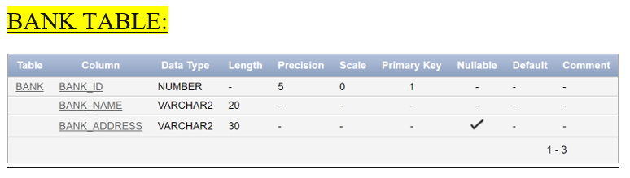
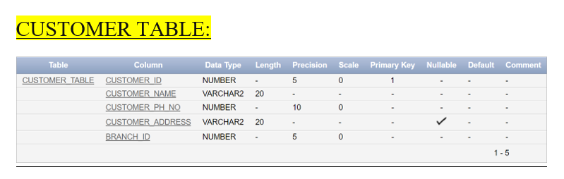
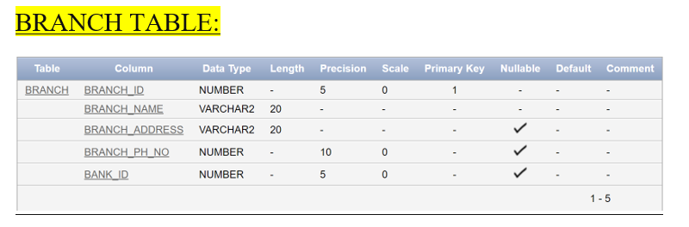
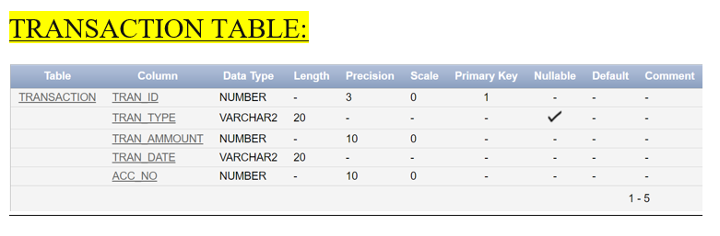
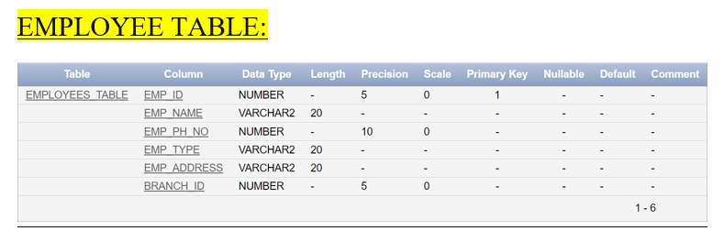
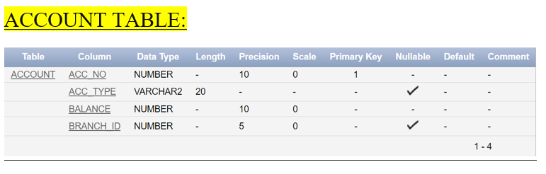
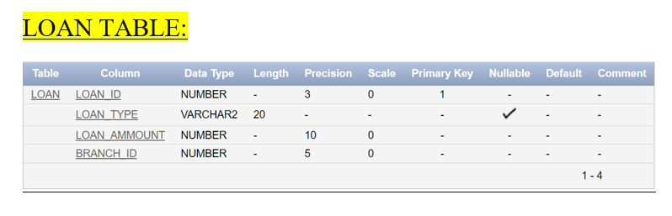
Tables description

Slide 10
04
Relational database schema
A set of instruction that describes the structure of the database..

Slide 11
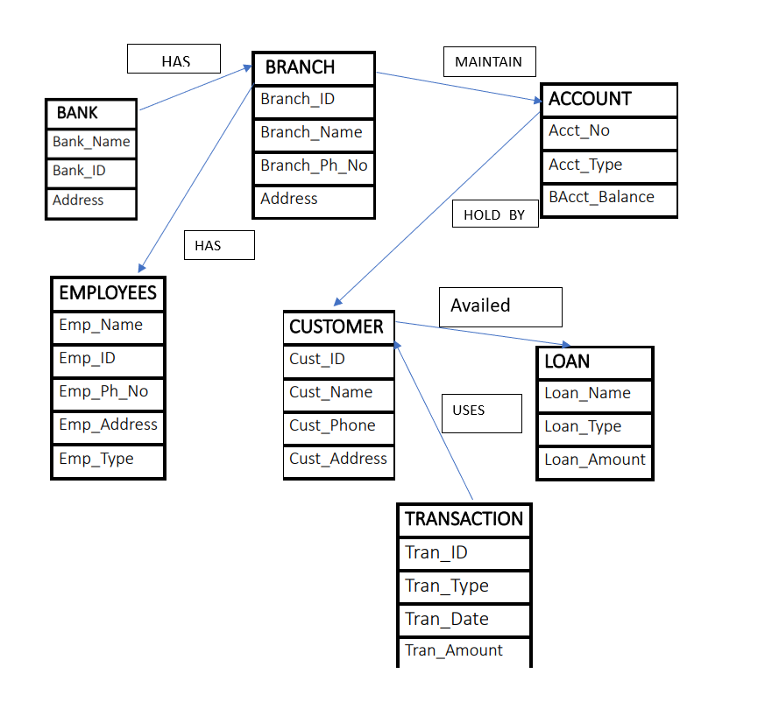
A relational database schema is a blueprint or a plan that defines the logical and physical structure of a relational database. It outlines the way data is organized in the database, the tables that will store the data, the relationships between the tables, and the constraints that ensure the integrity and consistency of the data.
The schema describes the structure of the database, including the names of the tables, the columns and their data types, and any constraints on the data. It also defines the relationships between the tables, which can be one-to-one, one-to-many, or many-to-many.

Slide 12
05
Normalization
A technique used in database engineering to organize data into tables and reduce data redundancy.

Slide 13
In order to prevent data redundancy, insertion anomalies, deletion anomalies, and update anomalies, the database's data must be organized. To achieve the following desirable properties:
Minimize the redundancy
Minimize the insertion, updation, and deletion anomalies, it can also be characterized as the top-down design process of the provided schema analysis based on its FDs and primary key
There are 6 types of normalization:
1NF
2NF
3NF
3.5NF(BCNF)
4NF
5NF

Slide 14
1NF(First Normal Form)
A relation is in one NF if and only if it has an atomic value for each of its attributes or a single valued attribute.
Requirements:
• Each table has a primary key.
• There are no repeating groups.
1NF Decomposition:
➢ Create a new table and put all the elements that are part of the repeating group in it.
➢ Give each newly created table a primary key.
➢ Copy the primary key of the table from which the repeating group was extracted into the new table, and vice versa.

Slide 15
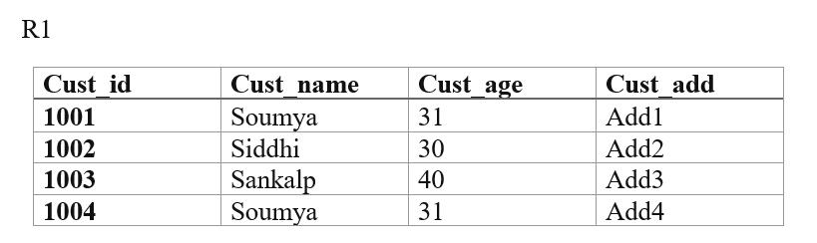
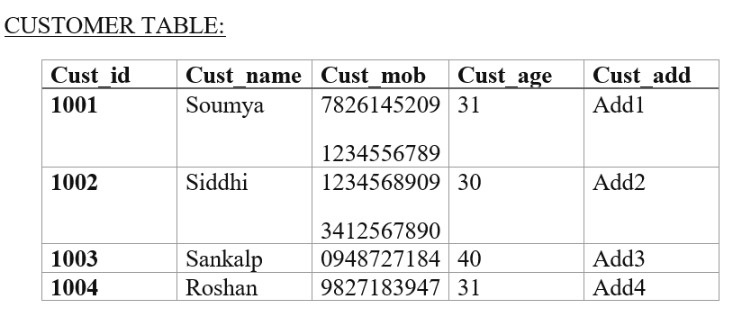
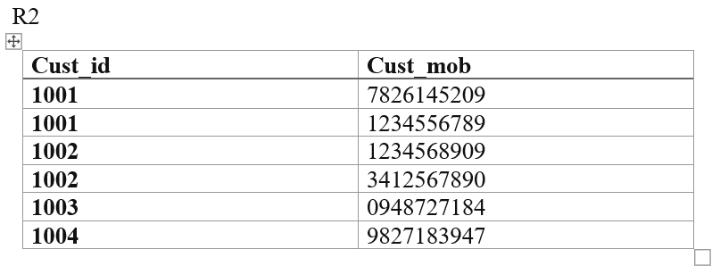
1 NF decomposition of the customer table

Slide 16
2NF(Second Normal form)
If a relation is only in one NF and all of them are totally functionally dependent on the primary key, it is said to be in two NF. Only a primary key with compound and composite attributes can be used to perform it.
Let us consider: cust_id = A, cust_name = B, cust_mob = C, cust_age = D, cust_address = E
So functional dependency set is F= {AB→CDE, D→ABC}
Now finding attribute closure of AB
AB+ = {ABCDE}
So, AB are candidate key and the prime attributes are A, B and D. Non-prime attributes are C and E. So cust_id→cust_address is partially dependent which is need to be decomposed.

Slide 17
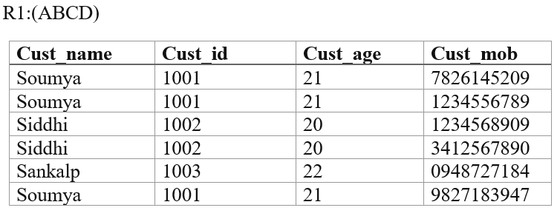
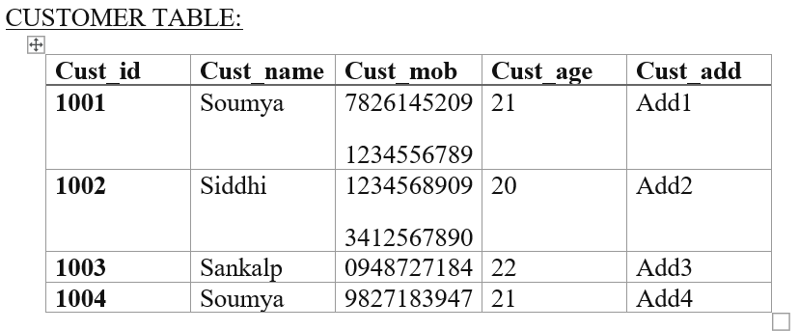
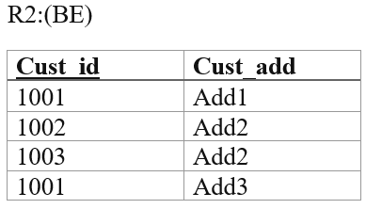
2 NF decomposition of the customer table

Slide 18
06
Conclusion

Slide 19
In summary, a bank database management system is a crucial instrument for controlling the enormous volume of data and transactions that take place within a banking establishment. The system offers a centralized database for managing and storing employee and branch data, financial transactions, and customer and account information. A relational and ER database schema with the proper entities, properties, and relationships should be part of any efficient bank database management system. A user-friendly interface, backup and recovery mechanisms, and data security measures should all be included in the system for quick data entry and retrieval. A bank database management system, in general, is a crucial part of the infrastructure of a bank and is necessary for guaranteeing smooth operations and providing top-notch customer service.

Slide 20
Thanks

